Slide 1

Flight Price Prediction
Created By – Snigdha Agarwal

Slide 2
Problem Statement
Flight ticket prices vary unexpectedly. The lowest available ticket on a given flight gets more and less expensive over time. This usually happens as an attempt to maximize revenue based on -
1. Time of purchase patterns (making sure last-minute purchases are expensive)
2. Keeping the flight as full as they want it (raising prices on a flight which is filling up in order to reduce sales and hold back inventory for those expensive last-minute expensive purchases)
We have to work on the data collected from different portals (e.g make my trip, ease my trip, yatra.com etc.) to make a model which can best predict the fares of flights depending on the different features.

Slide 3
Conceptual Background of the Domain Problem
The project will require knowledge and practice in building Graphs /plots and analyzing them to get the relationship between dataset, Knowledge of Different Learning Models to build and predict the required output. Basic Data science concepts are used to increase the quality of the dataset and Python Knowledge (Coding Language) which will be used to solve the flight price prediction project. Understanding the calculation of R2 Score, MSE, skewness and basic mathematics/statistical approaches will help to build an accurate model for this project.

Slide 4
EDA performed on the dataset
1) Shape of the dataset : We have 2410 rows and 9 columns in our raw dataset
2) Data types of the columns:
We have int, float and object type variable in dataset
3) There is no null values present in the dataset
4) Duplicates are checked
5) Outliers are checked and treated

Slide 5
Insights of the dataset:
1).The best time to book a flight seems to be one month before the date of the journey. Drastic difference in fares can be seen with increase in time frame of date of journey and day of booking.
2). The flight fare increases as we get near the departure date. Indigo price fare can be observed to be cheaper. Morning Flights are cheaper as compared to flights going in afternoon or Night.
3).

Slide 6
Scaling the data
We Scaled the data using MinMaxScaler methodology
Code Logic Snippet
scaler = preprocessing.MinMaxScaler()
minmax_df = scaler.fit_transform(fin_df)
final_df = pd.DataFrame(minmax_df, columns = fin_df.columns)

Slide 7
Removing Skewness
We tried different methods to remove skewness -> Log method, Sqrt method, Power Method,
Power Method removed the skewness perfectly.
Code Snippet:
fin_df_new=power_transform(final_df)
fin_df_new = pd.DataFrame(fin_df_new,columns=final_df.columns)

Slide 8
Model training
We used different Models and compared the accuracy of the models:
Linear Regression
Decision Tree
Lasso
Ridge
Random Forest

Slide 9
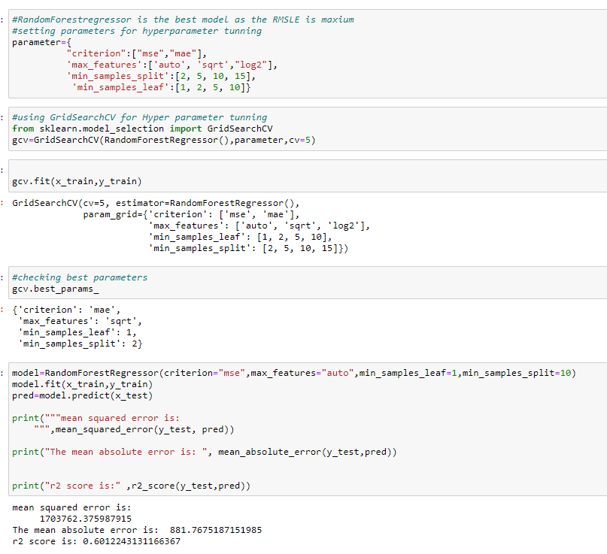
Hyper parameter Tunning
GridsearchCv has been used for hyperparameter tunning
Then the model was retrained with the best parameters

Slide 10
Conclusion: This research showed the model training process for the prediction of the Price. One of the objectives of the paper was to check the important variable for the prediction of the price and how these variables describe the price. Through model training and evaluating its performance. RandomForestRegressor proved to be as best model. As the difference between the r2score and cross validation score was minimum. This project has increased my understanding of the concept.

Slide 11
Thank you

